Slide 1

Wine-o-mania
Kurt Held
Saurav Mitra
Diamond Williams
Karista Williams

Slide 2
How do I pick a bottle of wine?
Location
Rating
Climate/Soil
Price
???

Slide 3
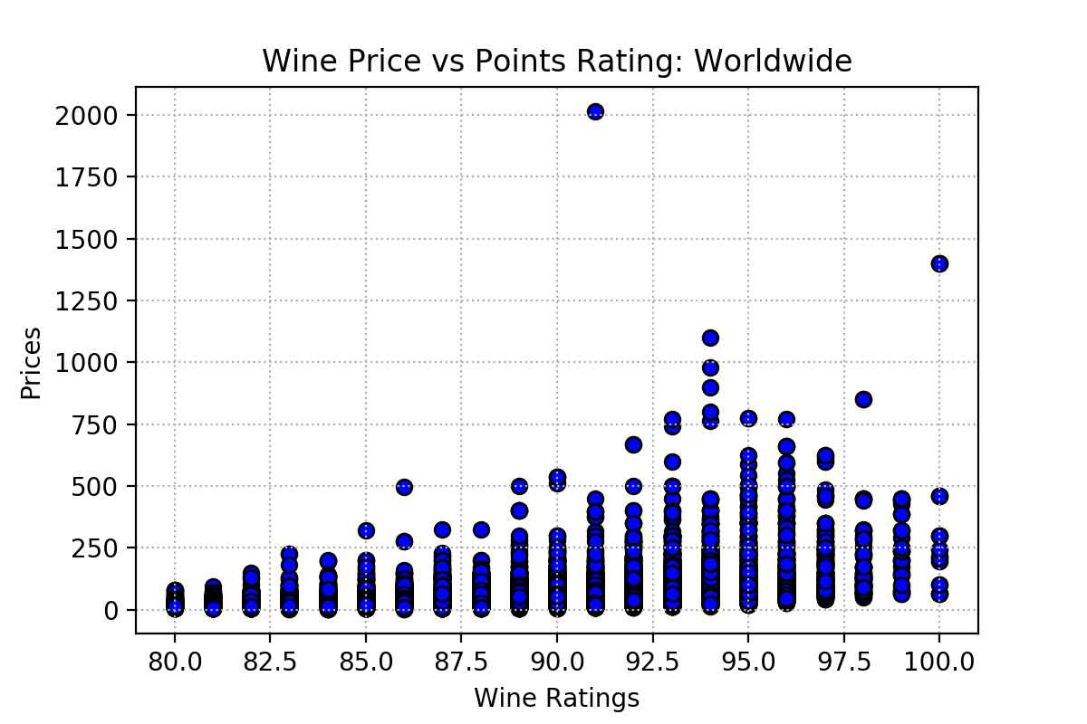
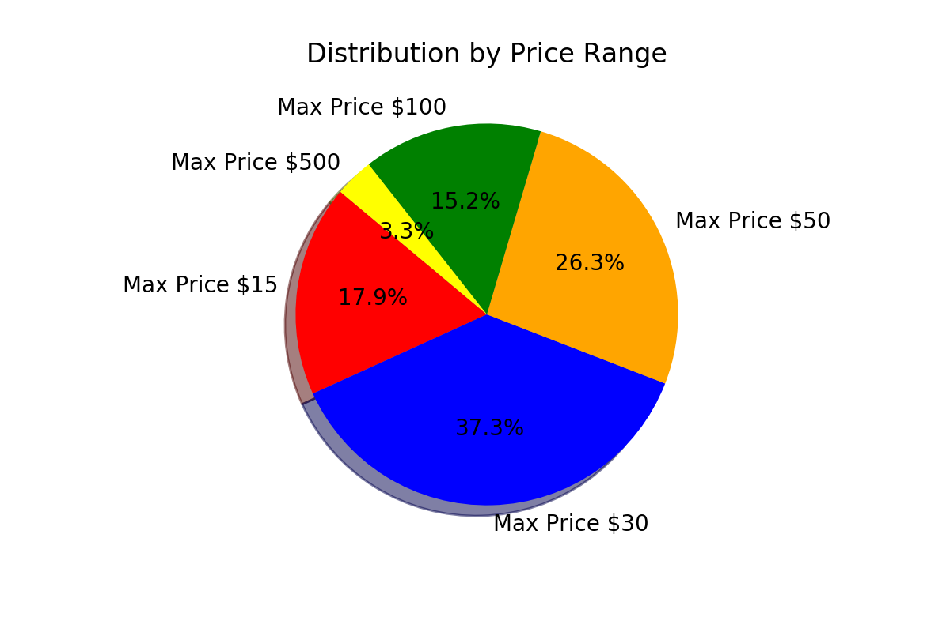
Price Distribution

Slide 4
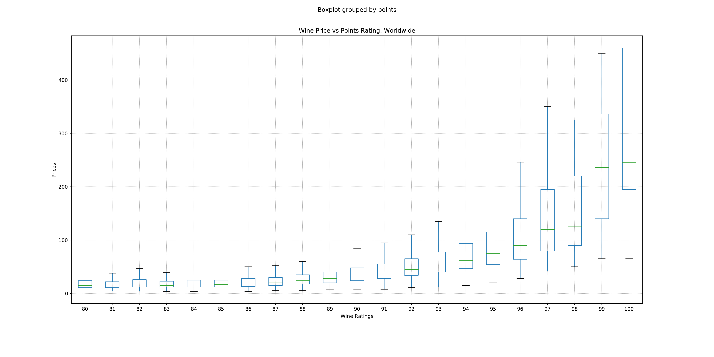
Price and Overall Rating
Do wine ratings drive prices?
Classic
Wine
(95-100)
($20-$1400)
Good Wine
(80-84)
($5-$225)
Very Good Wine
(85-89)
($4-$500)
Outstanding
Wine
(90-94)
($8-$1100)

Slide 5
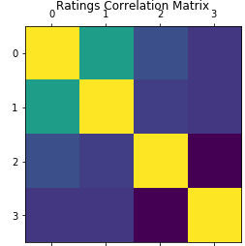
Rating and locating
1.00
0.476
0.100
0.003
positive high impact
0.476
1.00
0.003
0.004
positive low impact
0.100
0.003
1.00
-0.188
Legend
0: rating
1: price
2: latitude
3:longitude
0.003
0.004
-0.188
1.00

Slide 6
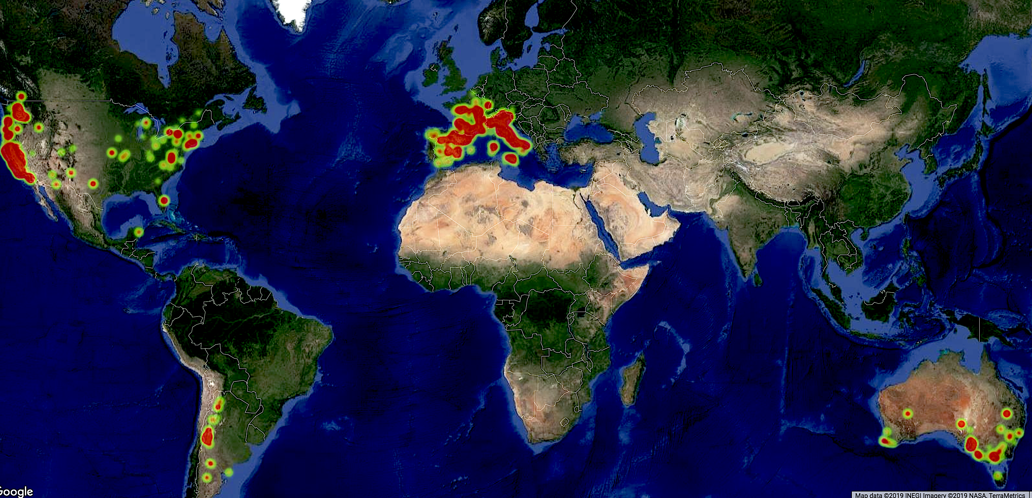
Wine Types by Location
Number of varieties of Wines available in each
location is represented by the radius of the hot-spots

Slide 7
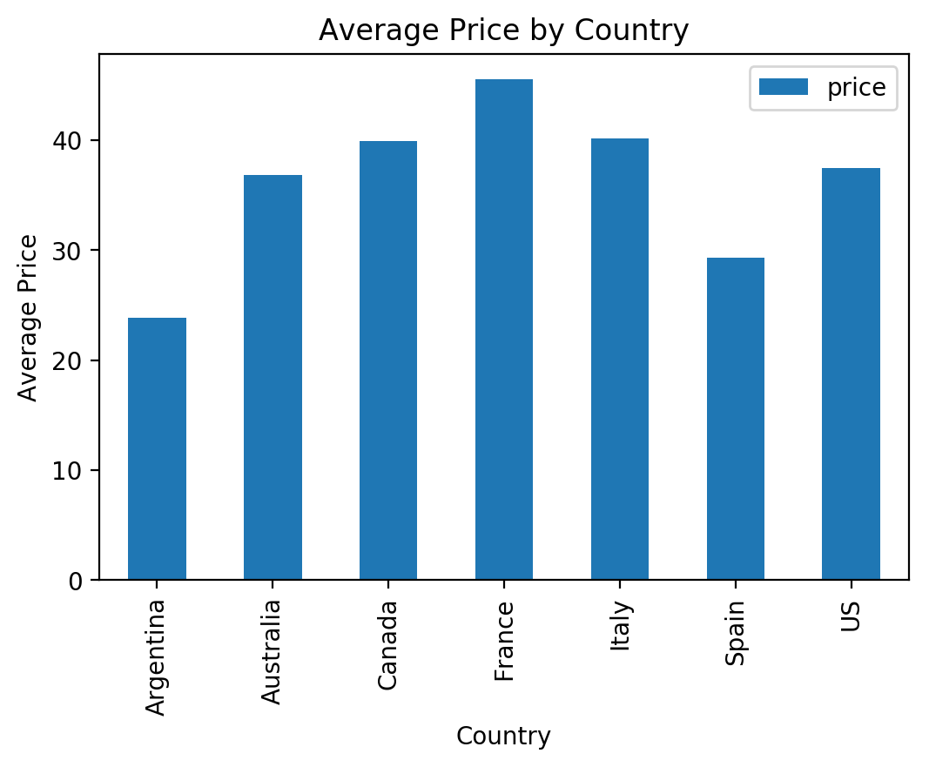
Price Country

Slide 8
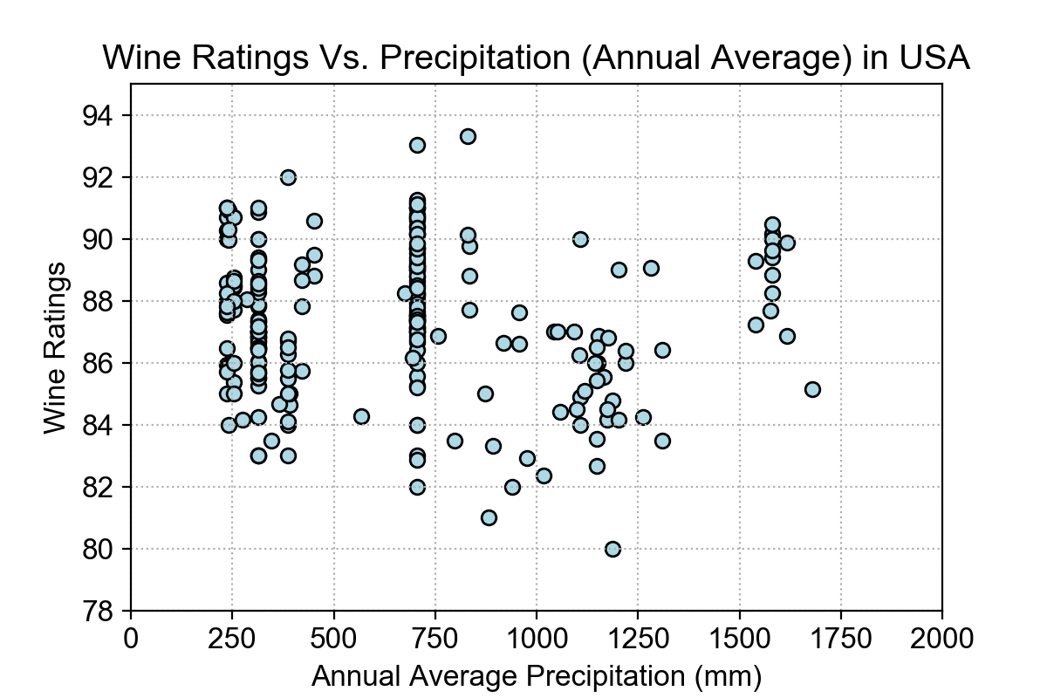
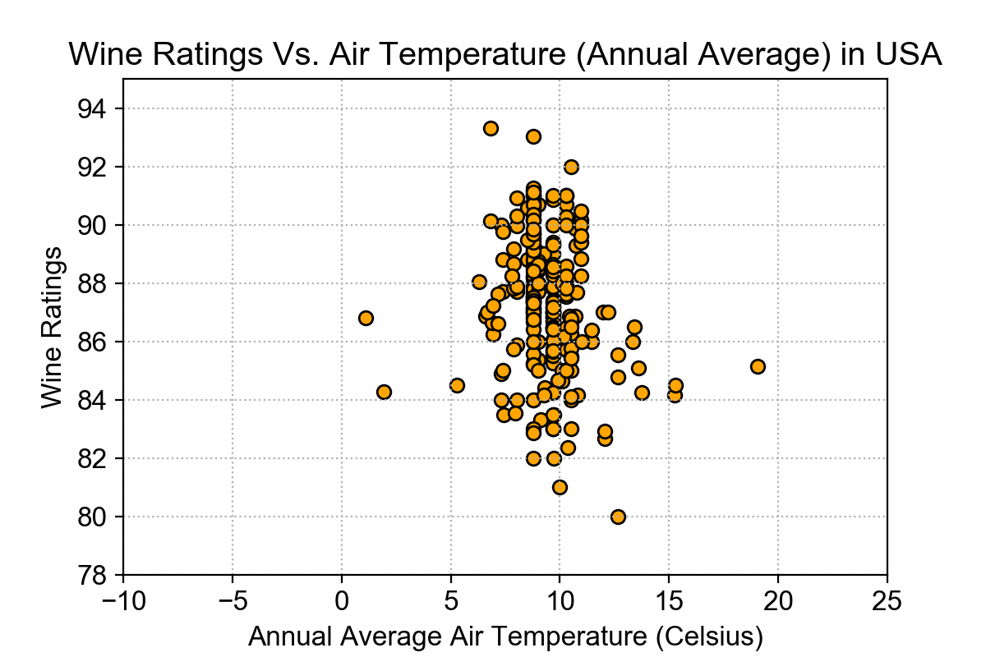
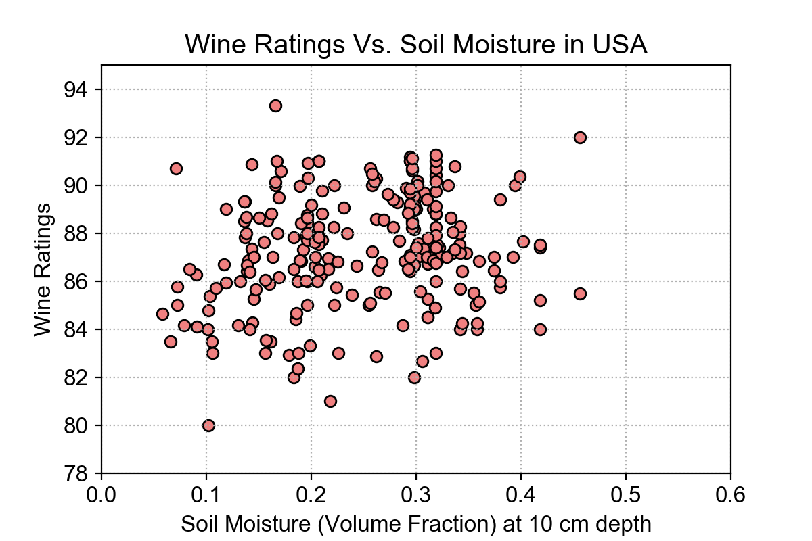
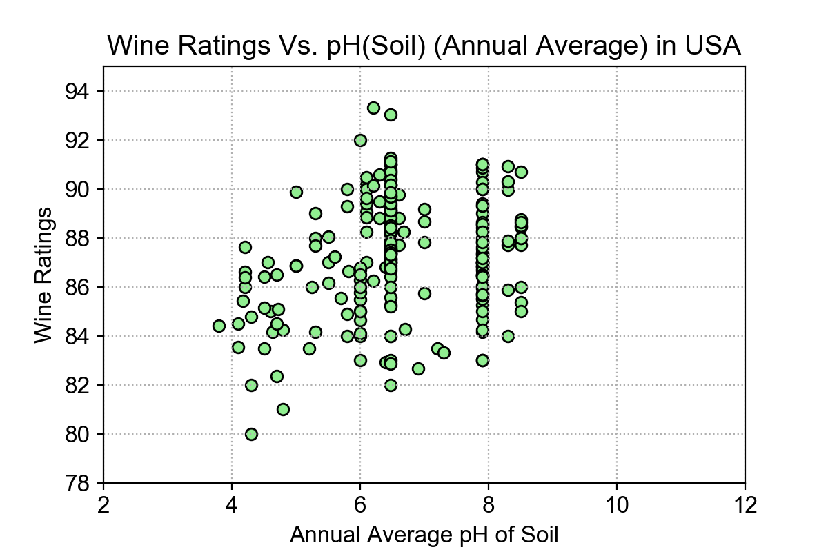
Wine Ratings by Climate and Soil
Optimal
Temperature
Range
6-12° C
Optimal
Precipitation
Range
200-800 mm
Optimal
Soil pH
Range
5.5-8.5
Optimal
Soil Moisture
Range
0.15-0.37

Slide 9
How do I pick a bottle of wine?
Location – does not affect prices or rating
Rating – does not affect price
Climate/Soil - determines grape growing location
Price – lots of really good inexpensive wines

Slide 10


Slide 11
BACKUP SLIDES

Slide 12
Data Source
We retrieved the original dataset from Kaggle.
The dataset contained 150k rows of information
Once the dataset was cleansed we had 77k
This was due to the dataset having a variety of missing values
After the dataset was cleansed we used Open Weather, USDA and Google Maps APIs to retrieve additional information

Slide 13
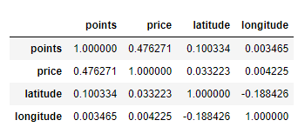
Rating and location
Ho: Wine ratings is impacted by the price and location of the wine
Ha: Wine ratings is not impacted by the price and location of the wine
1.00
0.476
0.100
0.003
0.476
1.00
0.003
0.004
0.100
0.003
1.00
-0.188
This means that the price and location has low significance to the wines rating; therefore we should accept the alternative hypothesis and reject the null hypothesis
0.003
0.004
-0.188
1.00

Slide 14
Price and Overall Rating
There is significant correlation between the cost of a wine and the ranking (points) assigned by wine critics
Classic
Wine
(95-100)
($20-$1400)
All wines | Good Wines | Very Good Wines | Outstanding Wines | Classic Wines
Pearson correlation coefficient between points and price
0.459867 | 0.313647 | 0.453946 | 0.254986 | 0.03738
Good Wine
(80-84)
($5-$225)
Very Good Wine
(85-89)
($4-$500)
Outstanding
Wine
(90-94)
($8-$1100)
Ho: ρ = 0
Wine price is impacted by its rating
Ha: ρ ≠ 0
Wine price is impacted by its rating
Level of significance = 1.645, with df = ∞
If r > 1.645, reject the null hypothesis
Null hypothesis rejected ➔ there is no significant correlation

Slide 15
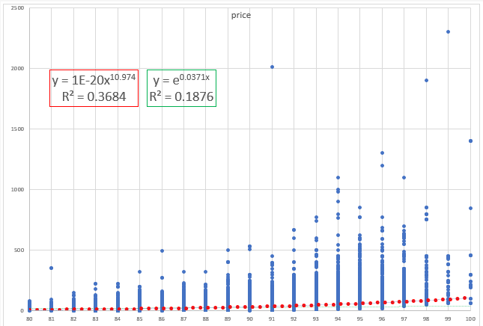
Price and Overall Rating
All wines | Good Wines | Very Good Wines | Outstanding Wines | Classic Wines
R-square for linear regression
0.470 | 0.689 | 0.691 | 0.614 | 0.477

